Slide 1
Spring security – OAuth2

Slide 2
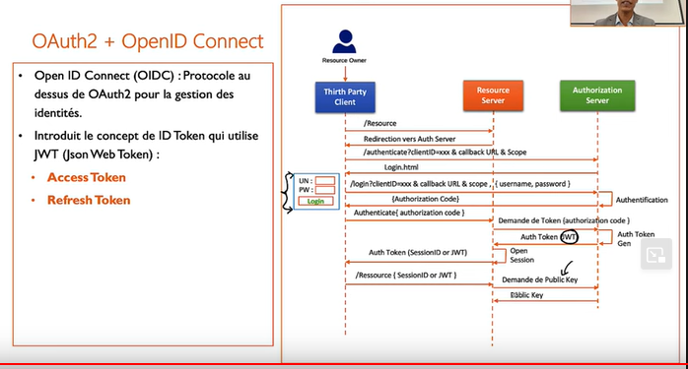
OAuth2 flow

Slide 3
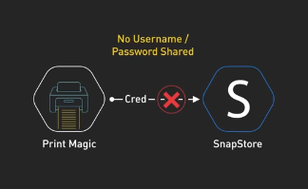
Permission based Authorization
OAuth 2.0 provides a secure way for users to authorize third-party applications to access their resources without sharing their credentials (like passwords).
permits client applications to access protected resources via an authorization server.

Slide 4
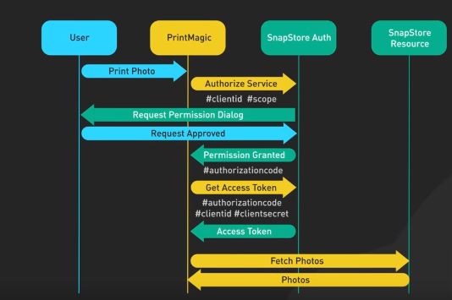
OAuth2 request work flow

Slide 5
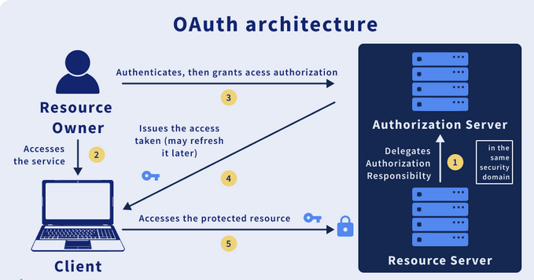
Permission based Authorization
Resource Owner/User: The owner of a resource, i.e., the individual who holds the rights to that resource.
Client: The application requests an access token (represents a user's permission for the client to access their data/resources), then accesses the protected resource server after receiving the access token.
Authorization Server: After successfully authenticating the resource owner and obtaining authorization, the server issues access tokens to the client.
Resource Server: It provides access to requested resources. Initially, it validates the access tokens, then it provides authorization.

Slide 6
Permission based Authorization
Resource Owner/User: The owner of a resource, i.e., the individual who holds the rights to that resource.
Client: The application requests an access token (represents a user's permission for the client to access their data/resources), then accesses the protected resource server after receiving the access token.
Authorization Server: After successfully authenticating the resource owner and obtaining authorization, the server issues access tokens to the client.
Resource Server: It provides access to requested resources. Initially, it validates the access tokens, then it provides authorization.

Slide 7
Permission based Authorization

